Slide 1
Financial Exploitation of Older Americans
Legal and Policy Solutions
Professor Katherine Porter UC Irvine Law

Slide 2
Financial Abuse of Elderly
What is financial exploitation in the context of older/elder Americans?
Definitions
Incidences
Consumer Financial Markets
Context for Abuse
Legal Tools to Combat Elder Financial Abuse
Applicable Statutes
Regulatory Approaches

Slide 3
Defining Elder Financial Abuse
Differs significantly from other forms of elder abuse
Physical abuse
Neglect
Involvement of others
family v. stranger
trusted intermediary v. seller
Financial Contexts
Credit or Banking
Purchasing Goods/Services
Retirement and Investing
Notes:
The National Center on Elder Abuse: financial exploitation as the “illegal or improper use of an elder’s funds, property, or assets”
Examples provided included cashing checks without authorization or permission, forging an older person’s signature, misusing or stealing an older persons money or possessions, coercing or deceiving an older person into signing a document (e.g., a contract or a will), and the improper use of a conservatorship or a guardianship, or a power of attorney.

Slide 4
Pure v. Hybrid Financial Exploitation
Pure (occurs in isolation)
Risk factors for victims
Profile of perpetrators
Hybrid (co-occurs with physical abuse or neglect)
Risk factors for victims
Profile of perpetrators
Law does not generally respond differently to these two kinds of financial exploitation, if harm/malfeasance is same
Notes:
Pure:
Risk factors of elderly: elder’s younger age, absence of communication problems, absence on dependence on others, absence of confusion/dementia, absence of childhood family violence, living alone, having no children, and a perceived good relationship with the perpetrator.
Perpetrator variables: an absence of a parasitic abuser (e.g., easy access to elder, lives off the elder), nonrelative and relative relationship status, having had children, and a trend toward an absence of intimate partner
violence in their current relationships.
Hybrid financial exploitation co-occurs with physical abuse and/or neglect)
While all forms of maltreatment of elderly persons have devastating consequences for the elderly person involved, HFE is perhaps the most entrenched (e.g., it is generally the longest in duration) and intractable (because it is characterized by mutual dependency between the elderly person and the perpetrator), the most difficult for APS to investigate, and with the most draconian outcomes for the victims of this
hybrid financial exploitation (HFE):
risk factors: presence of childhood family violence, cohabitation with the perpetrator, widowed status, poor health, inability to drive, feelings of isolation (trend), fear of the perpetrator, perceptions of the perpetrator as a caretaker, and long history of abuse
Perpetrator variables included parasitic abuser, being a family member, unemployed, inability to drive, and financially dependent upon the elder.
Legal tools to combat these are often the same.
PFE is a more diverse group than HFE elderly victims and perpetrators

Slide 5
Statistics on Elder Financial Abuse
About 11% of people ages 60+ faced some form of elder abuse; 5.7 million people.
BUT this is all forms of abuse. No good national data on elderly financial exploitation.
While seniors 60 and older make up 15 percent of the U.S. population, they account for roughly 30 percent of fraud victims Americans over 65 years lost $2.9 billion in 2010
12% increase from 2008
Underreported
Gendered problem: Women Fare Worse
More likely to be victims of financial exploitation
Fewer financial resources (income and assets)
Notes:
MetLife study for data---2009 report estimated $2.5 billion each year.
National Institute of Justice study, almost 11% of people ages 60 and older (5.7 million) faced some form of elder abuse in the past year. A 2009 study estimated that 14.1 percent of non-institutionalized older adults nationwide had experienced some form of elder abuse in the past year. Financial exploitation of older adults is increasingly alarming. A 2009 report by the MetLife Mature Market Institute and the National Committee for the Prevention of Elder Abuse (NCPEA) estimates that seniors lose a minimum of $2.5 billion each year.

Slide 6
Consumer Financial Markets
Providers
Consolidation in Large Banks
Technological Sophistication
Trends in Products
Complex; more moving parts
More credit available
Legal Changes
Fractured Regulatory Authority
Preemption

Slide 7
Legal Tools: Elder Abuse Victims Act
Pending in Congress. Introduced 3/11.
Would establish Office of Elder Justice in DOJ
Requires studies, review of laws, data collection

Slide 8
Legal Tools: Applicable Statutes
Disclosure
Mandatory Education
Substantive product standards
Sales or marketing practices
Licensing, certification, fiduciary duties
Complaint resolution
Notes:
Disclosure—normally general applicability. Example is TILA. Often ineffective, especially for those with least financial sophistication, most trust.
Mandatory education—rare. Example is reverse mortgage mandatory counseling from HUD.
Substantive product standards---Example is CARD Act. Contested, normally preference for disclosure. Genlly applicable.
Sales or marketing—Example is cooling off period where you can rescind in-home solicitations—designed to let people say “yes” to get salesperson out of home and then change mind.
Licensing—Most common in financial advisors context. SEC. Mortgage brokers is example of where this was difficult.

Slide 9
Legal Tools: UDAP and UDAAP
Unfair
the act or practice causes or is likely to cause substantial injury to consumers which is not reasonably avoidable by consumers; and
such substantial injury is not outweighed by countervailing benefits to consumers or to competition.
Deceptive is not defined
Abusive
Materially interferes with the ability of a consumer to understand a term or condition of a consumer financial product or service; or
takes unreasonable advantage of [lack of understanding of consumer, inability of consumer to protect their interests, or reasonable reliance of consumer of person to act in interests of consumer]
Notes:
UDAP--- standard tool. Iowa only recently added private right of action. New definition of abusive at federal level.
Complaints—financial regulators and FTC required to take.
UDAP. Read out statutory language.

Slide 10
Legal Tools: Regulatory Entities
Consumer Financial Protection Bureau
Office of Older Americans
Financial Advisers
Reverse Mortgages
Headed by Hubert (“Skip”) Humphrey III
Notes:
Also U.S. Senate Special Committee on Aging

Slide 11
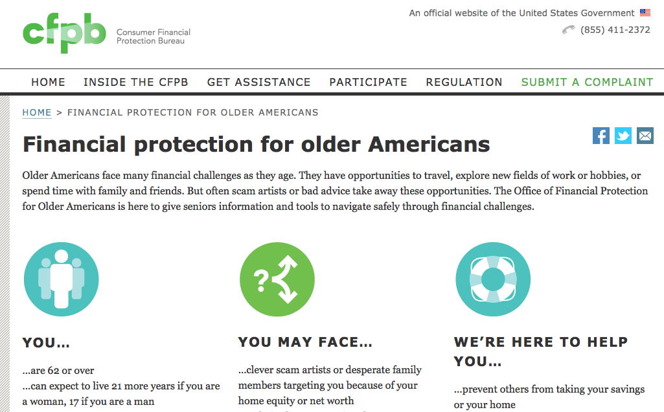

Slide 12
Legal Tools: Regulatory Entities
Consumer Financial Protection Bureau
Federal Trade Commission
Other federal agencies with departments, such as Administration on Aging (HHS).
State Attorneys General
In Iowa, 1 full time prosecutor and 1 full-time investigator. Focus is on criminal enforcement for elder fraud.
Biggest problem is investor fraud
Notes:
Also U.S. Senate Special Committee on Aging

Slide 13
Problem E.1
You are in-house counsel to Big Hearted Bank. The bank president’s 83-year old grandmother, Alma, was the victim of financial scam.
On Monday, a stranger came to her home to test the radon level. He politely introduced himself as Jim Jangle and appeared in a uniform with a badge. Jangle told Alma the radon level was very high in her home and orally cited statistics on the dangers of radon, including cancer, and health risks to her young great-grandchildren.
He stated that he could remediate the radon problem for $5,000, which was a discount of $250 if she agreed today and provided a bank account for a direct withdrawal. She handed him her check book from MidBank so he could copy her checking account information.

Slide 14
Problem E.1
A week has passed, and Jangle has never returned to do the remediation. MidBank paid the withdrawal on Tuesday. Alma told your boss, her grandson, about this situation on Friday.
Your boss wants you to work on this from at least two angles.
Can Alma recover the money? How?
What processes/strategies should Big Hearted Bank adopt to help its older clients avoid scams like this.

Slide 15
Problem E.1 Getting $ Back
Does Alma have the legal right to reverse the bank withdrawal? Can she force MidBank to put the money back in her account? If so on what basis? If not, what are available legal remedies that could return the money to her?
Notes:
Generally applicable law. ACH—very hard to reverse. 60 days to notify financial institution. Need to recognize problem quickly. Shame in telling about problem. Bank cannot condition on a fee but can require complete affidavit (“written statement under penalty of perjury”) necessary to reverse. Also difficulty in believing it was her fault. That translates into reluctance to do affidavit.. Why make these hard to reverse? Genlly applicable law when put to elderly consumers may not provide enough protection. Also issue of consumer v. commercial transaction. Commercial law often balances both.
3 days for in-home cooling off—but more than that has passed.

Slide 16
Problem E.1 Getting $ Back
Electronic Funds Transfer Act
Unfair and Deceptive Practices Act
Complaint to government agencies
CFPB
State AG
Banking commissioner
District Attorney
Complaint to bank
Notes:
Generally applicable law. EFT act. ACH—very hard to reverse. Need to recognize problem. Shame in telling her. Why make these hard to reverse? Genlly applicable law when put to elderly consumers may not provide enough protection. Also issue of consumer v. commercial transaction. Commercial law often balances both.
With UDAP, who are you going to sue??? Jangle can’t be found or will be judgment proof. Surely bank following fedl law on transfers does not violate UDAP?

Slide 17
Problem E.1 Bank Processes/Strategy
Big Hearted Bank wants to help its older clients avoid these scams. The President would like you to develop a list of procedures or strategies that it can use to prevent elderly financial exploitation. What is on your list?
Notes:
procedures/sensitivites. (See AZ for list of ideas)
Particularly ask re processes that would violate ECOA—fin. Testing? Ban on products for older—maybe not give them overdraft.

Slide 18
Problem E.1 Bank Processes/Strategy
Education
Staff training
Financial driving license
Require additional validation
Ban on products or processes
Specialized products
Notes:
Procedures/sensitivites. AZ AG has list.
With education: Do they attend? How do you stay ahead of scams?
Finnancial driving licenses, bans, additional validation all potential run afoul of ECOA if brought into old age context.
Particularly ask re processes that would violate ECOA—fin. Testing? Ban on products for older—maybe not give them overdraft.
Example of specialized products—protected account subject to more scrutiny. Seniors Card or checking account with more limits on things.

Slide 19
Problem E.2
You are in-house counsel to Card Issuer. You notice that about 25% of the complaints made to the CFPB about Card Issuer are from older consumers (age 65+). Most of these complaints appear to result from consumers failing to understand aspects of the card, such as the fact that missing a single payment can result in a default APR or that the company may allow the consumer to exceed the credit limit.
What do you advise Card Issuer to do?

Slide 20
Equal Credit Opportunity Act 15 U.S.C. 1691
It is “unlawful for any creditor to discriminate against any applicant, with respect to any aspect of a credit transaction—
(1)on the basis of race, color, religion, national origin, sex or marital status, or age (except capacity to contract).”
It is not discrimination to:
“to use any empirically derived credit system which considers age if such system is demonstrably and statistically . . . except that in the operation of such system the age of an elderly applicant may not be assigned a negative factor or value; or
to make an inquiry or to consider the age of an elderly applicant when the age of such applicant is to be used by the creditor in the extension of credit in favor of such applicant.”

Slide 21
Problem E.2
Do nothing!
Default APR and overlimit fees are source of substantial profit for banks.
ECOA may limit your ability to tailor credit products for older Americans
CFPB complaints require “objective, verifiable, monetary relief.” Pay that as cost of business.
Product simplification
Reputation concerns may trump additional profits
Notes:
Default APR is good news so long as it is sporadic caused by mistakes and not a sign of serious financial distress.
Exceeding limit is okay under CARD Act. Just can’t charge overlimit fee. But you can let them go overlimit without fee. That makes them happy and builds loyalty. You CAN charge overlimit fee if they opt-in. Older Americans more likely to do so???? One size fits all procedure/communication for opting-in but different cognitive abilities.
Law on CFPB complaints—relief definition. Just pay this as cost of doing business.
Product simplification would also reduce profits and access to credit. It is ability of issuers to tailor products to user groups that makes them profitable.

Slide 22
Problem E.3
You are a deputy assistant to Chief of the CFPB’s Office of Older Americans.
The complaint division reports that it has recently gotten a handful of complaints about the following type of transaction:
Older American is given a lump sum of money by a stranger to purchase a life insurance policy. The stranger is the named beneficiary of the policy.
The complaint division would like the Office of Older Americans to handle this issue. What do you advise?
Notes:
STOLI. The scammer offers an elderly person a lump sum if they will buy a life insurance policy, at the scammer's expense, naming the scammer as beneficiary.

Slide 23
Problem E.3
What are the harms here?
Are these illegal?
If not, should they be?
If so, what are the remedies?
Notes:
Seniors are hurt in several ways by this scheme. They may lose the ability to buy additional insurance. The money they receive from this illegal transaction is taxable, putting them in the double-bind many criminals encounter; pay taxes, thereby exposing the scam, or not pay taxes, and face tax evasion. They could also end up being charged with theft or sued by the issuing insurance company.
NOT in CFPB’s jurisdiction. Not a consumer financial product, not covered by federal consumer law. Have to go to state insurance commissioners.

Slide 24
Financial Exploitation of Older Americans
Legal and Policy Solutions
Professor Katherine Porter UC Irvine Law

