Slide 1
Surrogate Health-Care and End-of-Life
Decision-Making for Individuals with Dementia
Josephine Gittler
Wiley B. Rutledge Professor of Law
Director, National Health Law and Policy Resource Center
College of Law, University of Iowa
Elder Law Colloquium
The Aging Population, Alzheimer’s and Other Dementias:
Law and Public Policy
February 9, 2012

Slide 2
ROADMAP
CONSTITUTIONAL AND STATUTORY FRAMEWORK
TOWARDS MORE EFFECTIVE ADVANCE PLANNING
PRESENT TRENDS
DEFAULT SURROGATES
CAPACITY FOR HEALTH-CARE DECISION-MAKING
BASIS FOR SURROGATE DECISIONS

Slide 3
1. CONSTITUTIONAL AND STATUTORY FRAMEWORK

Slide 4

Common Law and
Constitutional Underpinnings
The Karen Quinlan case
The Nancy Cruzan case
The Terri Schiavo case

Slide 5

History of Advance Directives
Living Will
Durable Power of Health Care Attorney
Advance Directive

Slide 6


Comparison of Iowa Code &
Uniform Health Care Decisions Act: Structure
  IC
  Life-Sustaining Procedures Act
    Living will is called declaration
    Chapter 144A (contains statutory form)
  Durable Power of Attorney for Health Care [Act]
    Chapter 144B (contains statutory form)
  UHCDA
  Combines living will (called individual instruction)and durable power of attorney for health care into advanced directives
  Integrates living will and power of attorney into one document

Slide 7
Iowa Code
Living Will (Declaration):
Scope & Applicability
“A competent adult may execute a declaration at any time directing that life-sustaining procedures be withheld or withdrawn. The declaration shall be given operative effect only if the declarant's condition is determined to be terminal and the declarant is not able to make treatment decisions.”
IC §144A.3 (1)

Slide 8
“A competent adult may execute a declaration at any time directing that life-sustaining procedures be withheld or withdrawn. The declaration shall be given operative effect only if the declarant's condition is determined to be terminal and the declarant is not able to make treatment decisions.”
IC §144A.3 (1)
"Declaration" means a document executed in accordance with the requirements of section 144A.3.”
IC §144A.2 (3)

Slide 9
“A competent adult may execute a declaration at any time directing that life-sustaining procedures be withheld or withdrawn. The declaration shall be given operative effect only if the declarant's condition is determined to be terminal and the declarant is not able to make treatment decisions.”
IC §144A.3 (1)
"Life-sustaining procedure" means any medical procedure, treatment, or intervention, including resuscitation, which meet both of the following requirements:
  Utilizes mechanical or artificial means to sustain, restore, or supplant a spontaneous vital function.
  When applied to a patient in a terminal condition, would serve only to prolong the dying process.
“Life-sustaining procedure" does not include the provision of nutrition or hydration except when required to be provided parenterally or through intubation or the administration of medication or performance of any medical procedure deemed necessary to provide comfort care or to alleviate pain.
IC §144A.2 (8)

Slide 10
“A competent adult may execute a declaration at any time directing that life-sustaining procedures be withheld or withdrawn. The declaration shall be given operative effect only if the declarant's condition is determined to be terminal and the declarant is not able to make treatment decisions.”
IC §144A.3 (1)
"Terminal condition" means an incurable or irreversible condition that, without the administration of life-sustaining procedures, will, in the opinion of the attending physician, result in death within a relatively short period of time or a state of permanent unconsciousness from which, to a reasonable degree of medical certainty, there can be no recovery.
IC §144A.2 (13)

Slide 11
Comparison of IC & UHCDA
Declaration/Instruction (Scope and Applicability)
  IC
A competent adult may execute a declaration at any time directing that life-sustaining procedures be withheld or withdrawn. The declaration shall be given operative effect only if the declarant’s condition is determined to be terminal and the declarant is not able to make treatment decisions.
IC §144A.3
  UHCDA
An adult … may give an individual instruction. … The instruction may be limited to take effect only if a specified condition arises.
SEC. 2 (a)
“Individual instruction” means an individual’s direction concerning a health-care decision for the individual.
SEC. 1 (9)

Slide 12
Iowa Code
Health Care Power of Attorney:
Scope and Applicability
An attorney in fact shall make health care decisions only if … :
  The durable power of attorney for health care explicitly authorizes the attorney in fact to make health care decisions.
IC §144B.3 (1)(a)

Slide 13
An attorney in fact shall make health care decisions only if … :
  The durable power of attorney for health care
  explicitly authorizes the attorney in fact to make
  health care decisions.
IC §144B.3 (1)(a)
"Durable power of attorney for health care" means document authorizing an attorney in fact to make health care decisions for the principal if the principal is unable, in the judgment of the attending physician, to make health care decisions.
IC §144B.1 (3)

Slide 14
An attorney in fact shall make health care decisions only if … :
  The durable power of attorney for health care
  explicitly authorizes the attorney in fact to make
  health care decisions.
IC §144B.3 (1)(a)
"Attorney in fact" means an individual who is designated by a durable power of attorney for health care as an agent to make health care decisions on behalf of a principal and has consented to act in that capacity.
IC §144B.1 (1)

Slide 15
An attorney in fact shall make health care decisions only if … :
  The durable power of attorney for health care
  explicitly authorizes the attorney in fact to make
  health care decisions.
IC §144B.3 (1)(a)
"Health care" means any care, treatment, service, or procedure to maintain, diagnose, or treat an individual's physical or mental condition….[but] does not include the provision of nutrition or hydration except when they are required to be provided parenterally or through intubation.
IC §144B.1 (4)
"Health care decision" means the consent, refusal of consent, or withdrawal of consent to health care.
IC §144B.1 (5)

Slide 16
IOWA CODE
Health Care Power of Attorney
Restrictions re Attorney in Fact
  IC
Attorney in fact can NOT be:
  the health-care provider, or an employee thereof, for the principal at the time of execution, unless a relative of the principal.
IC §144B.4

Slide 17
Comparison of IC & UHCDA:
Declaration/Instruction (Execution)
  IC
Declaration:
  must be in writing and dated,
  must be witnessed by 2 persons, and
  must be notarized.
Witness cannot be the health-care provider or an employee thereof attending the declarant at the time of declaration execution, or a person less than 18 years of age.
At least one witness must be a non-relative.
IC §144A.3 (2)
  UHCDA
Instruction:
  Can be oral or written
SEC. 2 (a)

Slide 18
Comparison of IC & UHCDA:
DPOA (Execution)
  IC
Durable power of attorney for health care:
  Must be able to write
  Must be witnessed by 2 persons, and
  Must be notarized.
Witness cannot be health care provider or employee thereof attending principal at time of DPA execution, person designated in DPA as attorney in fact, or person less than 18.
At least one witness must be non-relative.
IC §144B.3(1) (b), (2), & (3)
  UHCDA
Power of attorney for health care:
  Must be in writing, and
  Must be signed by the principal.
SEC. 2 (b)

Slide 19
Drafting Advance Directives:
Compliance with State Laws
Problem
You have a client, Mrs. MacBeth, who is a widow and is 73 years old. She spends the summer at her condominium in Des Moines, Iowa, and the winter at her condominium in Fort Lauderdale, Florida. She usually spends the fall with her daughter-in-law in Indianapolis, Indiana, and the spring with her daughter and grandchildren in Las Vegas, Nevada. She asks you to draft an advance directive that will be respected in all four states.

Slide 20
Drafting Advance Directives:
Compliance with State Laws
Ranges of conditions (and their definitions) that may be addressed or that may be pre-conditions for implementation of the directive, e.g., terminal condition, permanent vegetative state, end-stage condition;
Proxy or agent requirements – states vary in who may serve as one’s health care agent;
Execution requirements—witnessing, attestation, notarization, and qualifications for who can be a witness;
State procedural requirements, such as certification of incapacity, certification of the patient’s condition, or revocation procedures;
State-specific “magic words” – i.e., prescribed phrases or mandatory language requirements, e.g., where an agent’s authority or the individual’s instruction must be worded in a particular way;
Mandatory disclosures or notices;
Special institutional protocols for execution, e.g., requiring an ombudsman or patient advocate to witness.

Slide 21
Drafting Advance Directives:
Compliance with State Laws
IC §144A.3 (4)
A declaration or similar document executed in another state or jurisdiction in compliance with the law of that state or jurisdiction shall be deemed valid and enforceable in this state, to the extent the declaration or similar document is consistent with the laws of this state. A declaration or similar document executed by a veteran of the armed forces which is in compliance with the federal department of veterans affairs advance directive requirements shall be deemed valid and enforceable.
UHCDA Sec.2(h)
An advance health-care directive is valid … if it complies with this [Act], regardless of when or where executed or communicated.

Slide 22
Drafting Advance Directives:
Use of Statutory Forms,
Mandatory vs. Optional
Problem
Hawaii Revised Statutes § 327E-16 states:
  “The following sample form may be used to create an advance health-care directive. This form may be duplicated. This form may be modified to suit the needs of the person or a completely different form may be used that contains the substance of the following form. …” [form omitted]

Slide 23
Federal Law:
Patient Self-Determination Act (1990)
Requires Hospitals, NHs, HHAs and HMOs in Medicare or Medicaid to:
  Give all adults at admission written info about:
      their health care decision-making rights, and
      facility policies with respect to advance directives;
  Ask them if they have an advance directive and document it in their medical record;
  Provide education to staff & community on issues re advance directives;
  Never discriminate based on advance directives.

Slide 24
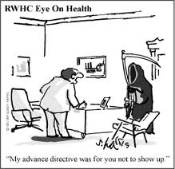
RWHC Eye on Health
“My advance directive was for you not to show up.”

Slide 25
2. TOWARDS MORE EFFECTIVE
ADVANCE PLANNING

Slide 26

Issues: Advance Directives
Specificity
Should your advance directive include as specific instructions as possible?
Only if you have a crystal ball and a medical degree.

Slide 27
Issues: Advance Directives
Specificity
Specific instructions are not helpful in unforeseen
circumstances.
Individuals’ wishes change over time as their
circumstances change.
Goals, values, and priorities more helpful to
consider.

Slide 28
Issues: Advance Directives
Compare:
If I’m terminally ill…
I don’t want artificial nutrition and hydration.
I don’t want surgery.
I want antibiotics.
What’s important to you...
How have you lived life?
Prolonging life vs. quality of life?
What’s a Benefit?/Burden?
Spiritual dimensions?
Financial issues?
How important control?

Slide 29


Issues: Advance Directives
Use a workbook approach…
      Consumer’s Took Kit for Health Care Advance Planning
      (ABA Commission on Law and Aging)
      http://www.abanet.org/aging/toolkit/
  Five Wishes (Aging with Dignity)
  http://www.agingwithdignity.org/five-wishes.php

Slide 30

Issues: Advance Directives
Health Care Power of Attorney
Selection of attorney in fact to exercise healthcare
power of attorney is the single most important issue.

Slide 31
Issues: Advance Directives
Health Care Power of Attorney
The ideal attorney in fact...
Meets the legal criteria.
Willing to speak on your behalf & handle the responsibility.
Able to act on your wishes, not his/her own.
Able to be at your side when needed, now and down the road.
Knows your values, priorities, goals.
Can listen and talk with you frankly & openly.
Able to manage conflict among family & others.
Strong advocate in the face of unresponsive doctor or institution.

Slide 32
Issues: Advance Directives
Enforcement/Implementation
    An invisible Advance Directive = no Advance Directive
      Wallet card
      Advance Directive registries
        (e.g.):
        USLivingWillRegistry.com
        Full Circle Registry: protectedlivingwill.com
        NationalLivingWills.com
        America Living Will Registry: ALWR.com

Slide 33
Issues: Advance Directives
Periodic Review
  An advance directive should be reviewed when …
    You reach a new DECADE
    You experience a DEATH
    of family or friend
    You DIVORCE
    You receive a new DIAGNOSIS
    You have a significant DECLINE
    in your condition as measured by
    Activities of Daily Living (ADLs)

Slide 34

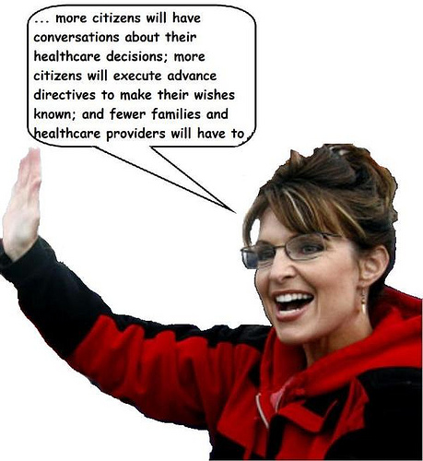
“Therefore, I, Sarah Palin, Governor of the state of Alaska, do hereby
proclaim April 16, 2008, as Healthcare Decision Day in Alaska.”

Slide 35
Pro-Life Advance Directives
Physicians For Life
www.physiciansforlife.org
International Task Force on Euthanasia and Assisted Suicide
www.internatinaltaskforce.org

Slide 36
Advance Directives
- 30 Years of Research-
  Most people don’t execute advance directives.
  Even when they do, standard form doesn’t provide much guidance.
  They seldom explain their wishes to att’ny in fact / agent.
  Health care providers often don’t know about the directive.
  Even if providers know directive exists, it isn’t in medical record.
  Even if in the record, it isn’t visible.
  Even if it is visible, doctors / health care providers may not follow.

Slide 37
What Advance Directives CAN’T Do
CAN’T provide Cookbook Directions.
CAN’T be a substitute for Discussion.
CAN’T Control health care providers.

Slide 38
What Advance Directives CAN Do
CAN be an important part of a developmental PROCESS of advance planning discussion
2. CAN help an individual stop and think and DISCUSS.
3. CAN empower and give DIRECTION if translated into the language of health care providers.

Slide 39
3. PRESENT TRENDS

Slide 40


Out-of-Hospital DNR Orders
& POLST

Slide 41
Do-Not-Resuscitate Order
A physician’s order written in a patient’s medical record indicating that health care providers should not attempt CPR in the event of cardiac or respiratory arrest. In some regions, this order may be transferable between medical venues. Also called a No CPR order, DNAR (do not attempt resuscitation) order, and an AND (allow natural death) order.

Slide 42
Out-of-Hospital
Do-Not-Resuscitate Order
An order written indicating that emergency medical personnel should not attempt CPR in the event of cardiac or respiratory arrest of an individual in a home/community-based setting.

Slide 43
Out-of-Hospital
Do-Not-Resuscitate Order
Iowa Code
§ 144A.7A

Slide 44

April 16, 2009

Slide 45
POLST =
Physician Orders for Life-Sustaining Treatment
Primary target group: Patients for whom death in a year
would not be a surprise.
Goal: To convert patient’s goals of care into a portable
set of medical orders addressing key decisions.
Requires:
    Find out patient’s wishes re: CPR, care goals
    (comfort vs. treatment), antibiotics, N&H.
        Translate into doctors orders on visually distinct
        (bright pink) standard form.
        Ensure form travels with patient.

Slide 46
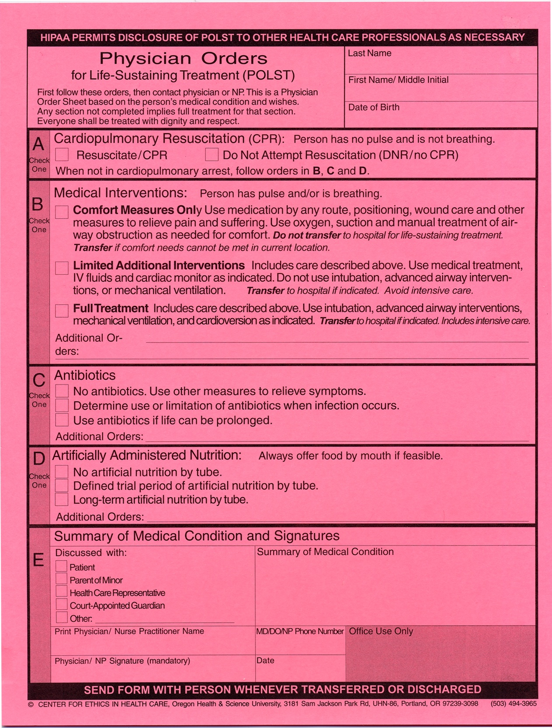
Top half…

Slide 47
Bottom half…

Slide 48
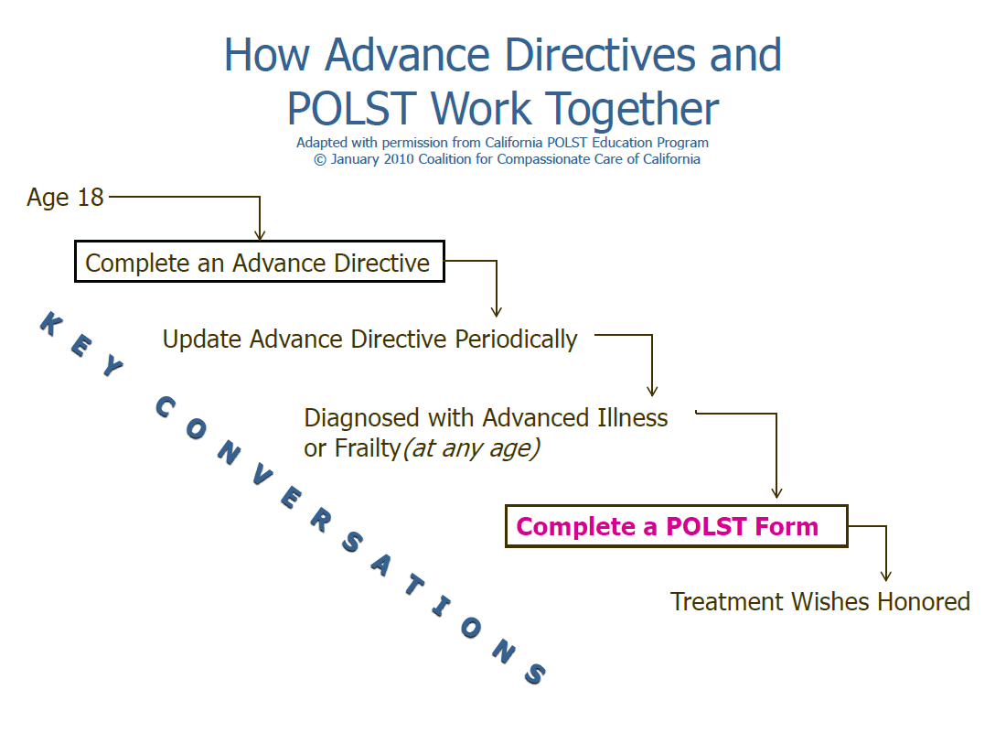

Slide 49
Bottom Line
A Communication Approach
versus
A Legal Transactional Approach

Slide 50
5. DEFAULT SURROGATES

Slide 51
Default Surrogates
IC §144A.7
(1)Life-sustaining procedures may be withheld or withdrawn from a patient who is in a terminal condition and who is comatose, incompetent, or otherwise physically or mentally incapable of communication and has not made a declaration in accordance with this chapter if there is consultation and written agreement for the withholding or the withdrawal of life-sustaining procedures between the attending physician and any of the following individuals, who shall be guided by the express or implied intentions of the patient, in the following order of priority if no individual in a prior class is reasonably available, willing, and competent to act:

Slide 52
Default Surrogates
IC §144A.7 (1)
The attorney in fact designated to make treatment decisions for the patient should such person be diagnosed as suffering from a terminal condition, if the designation is in writing and complies with chapter 144B or section 633B.1.
The guardian of the person of the patient if one has been appointed, provided court approval is obtained in accordance with section 633.635, subsection 2, paragraph "c". This paragraph does not require the appointment of a guardian in order for a treatment decision to be made under this section.
The patient's spouse.
An adult child of the patient or, if the patient has more than one adult child, a majority of the adult children who are reasonably available for consultation.
A parent of the patient, or parents if both are reasonably available.
An adult sibling.

Slide 53
Default Surrogates
IC §144A.8
1. An attending physician … who is unwilling to comply with the provisions of section 144A.7 shall take all reasonable steps to effect the transfer of the patient to another physician.
2. If the policies of a health care provider preclude compliance with the declaration of a qualified patient under this chapter or preclude compliance with the provisions of section 144A.7, the provider shall take all reasonable steps to effect the transfer of the patient to a facility in which the provisions of this chapter can be carried out.

Slide 54
Default Surrogates
UHCDA SECTION 5.
An adult or emancipated minor may designate any individual to act as surrogate by personally informing the supervising health-care provider. In the absence of a designation, or if the designee is not reasonably available, any member of the following classes of the patient’s family who is reasonably available, in descending order of priority, may act as surrogate:
  the spouse, unless legally separated;
  an adult child;
  a parent; or
  an adult brother or sister.
If none of the individuals eligible to act as surrogate under subsection b) is reasonably available, an adult who has exhibited special care and concern for the patient, who is familiar with the patient’s personal values, and who is reasonably available may act as surrogate.

Slide 55
4. CAPACITY FOR HEALTH-CARE
DECISION-MAKING

Slide 56
Determining Capacity for Health-Care Decision-Making
Tests
  Evidencing a choice
  “Reasonable” outcome of choice
  Choice based on “rational” reasons
  Ability to understand
  Actual understanding

Slide 57
Determining Capacity for Health-Care Decision-Making
UHCDA SECTION 1.
“Capacity” means an individual’s ability to understand the significant benefits, risks, and alternatives to proposed health care and to make and communicate a health-care decision.

Slide 58
Determining Capacity for Health-Care Decision-Making
Problem
A 72-year-old woman is seen by a physician for a preoperative evaluation prior to a total hip replacement. Her medical history includes early-stage Alzheimer’s disease. At a recent clinic visit, her sister says she is forgetful and confused; her Mini-Mental State Examination (MMSE) score was 21 out of 30 points. When the physician asks her what she understands about the risks and benefits of the planned procedure, she smiles and says it will fix her hip. When given information about risks and alternative treatment options and query about her understanding, she continues to smile and replies, “It’ll be okay.”

Slide 59
6. BASIS FOR SURROGATE
DECISIONS

Slide 60

Basis for Surrogate Decisions
Previously expressed desires
Substitute judgment
Best interests

Slide 61
Accuracy of Surrogate Decision-Making
“Several studies have examined the accuracy of surrogate decisionmakers by presenting individuals with hypothetical scenarios and asking them to indicate their treatment preferences for each scenario. Potential surrogates are simultaneously asked to predict the preferences of the individuals. These studies consistently demonstrate that the potential surrogates’ predictions do not reach a statistically significant degree of agreement with the choices of the individuals. This holds true even when individuals chose people that they would feel most comfortable with as surrogate decisionmakers.”
David Orentlicher, The Limitations of Legislation,
53 Md. L. Rev. 1255, 1278 (1994).

Slide 62
The End!

